Slide 1

Postpartum Depression Prediction
MD Tahiadur Rahman (20200204003)
Adiba Amin (20200204012)
MD Rafiu Alam Rafi (20200204051)

Slide 2
Table of Contents
Literature
Review
Introduction
Motivation
Result & Comparison
Limitations &
Future Work
Methodology
Conclusion

Slide 3
Introduction

Slide 4

Introduction
This analysis examines postpartum depression and its link to suicide. By identifying key risk factors, we aim to develop targeted interventions to prevent these tragic outcomes among new mothers. Understanding these elements is crucial for improving maternal mental health and ensuring the well-being of both mothers and their families.

Slide 5
Motivation

Slide 6

Motivation
Significant Impact: PPD affects many new mothers, leading to sadness, anxiety, and exhaustion.
Early Detection Crucial: Vital for the health and well-being of both mother and baby.
Current Challenges:
Stigma: Mothers often hesitate to seek help.
Symptom Variation: Diverse symptoms make diagnosis difficult.
Resource Limitations: Lack of adequate resources and trained professionals.

Slide 7
Why a Predictive Model?
Objective and Reliable: Offers a consistent method to identify at-risk mothers.
Scalable: Can be used in various healthcare settings.
Promotes Early Intervention: Enables timely support and treatment to prevent escalation.

Slide 8
Goals:
Improve Detection: Enhance early PPD detection.
Support Mothers: Offer timely help and improve quality of life.
Reduce Stigma: Promote understanding and encourage seeking help.
Better Understanding of ML: Understanding the approach, uses, variations and modifications of different ML models.

Slide 9
Literature Review

Slide 10
Research and publications
Machine Learning Methods for Predicting Postpartum Depression: Scoping Review
Application of machine learning in predicting the risk of postpartum depression: A systematic review
Used models:
1)SVM
2)Random Forest
3)Gradient Boost
4)Logistic Regression
Used models:
1) SVM
2)Random Forest
3)Logistic Regression

Slide 11
Research and publications
Machine Learning-Based Predictive Modeling of Postpartum Depression
Predicting women with depressive symptoms postpartum with machine learning methods
Used models:
1) Random Forest (RF)
2) SVM
3) Stochastic Gradient Boosting
4) Recursive Partitioning and Regression Trees
5) Naïve Bayes
6) KNN
7) Logistic Regression
8) Neural Network
Used models:
1) Ridge Regression
2) LASSO Regression
3) Gradient Boosting Machines
4) Distributed Random Forests (DRF)
5) Extreme Randomized Forests (XRT)
6) Naïve Bayes
7) Stacked Ensembles

Slide 12
Research and publications
Development and validation of a machine learning algorithm for predicting the risk of postpartum depression among pregnant women
Machine Learning Models for the Prediction of Postpartum Depression: Application and Comparison Based on a Cohort Study
Used models:
1) Ridge Regression
2) Gradient Boosting Machines
3) Extreme Randomized Forests (XRT)
4) Distributed Random Forests (DRF)
5) Naïve Bayes
6) Stacked Ensembles
Used models:
1) Support Vector Machine (SVM)
2) Random Forest (RF)

Slide 13
Methodology

Slide 14
Methodology
01
02
03
04
05
Data
Collection
Data
Preprocessing
Feature
Selection
Model
Development
Model
Evaluation

Slide 15
Results & Comparison

Slide 16
Model Evaluations
Model | Precision | Recall | F1-Score | Accuracy
Decision Tree | 0.94 | 0.93 | 0.94 | 0.92
Random Forest | 0.94 | 0.91 | 0.93 | 0.91
Naïve Bayes | 0.62 | 0.73 | 0.67 | 0.60
Gradient Boosting | 0.85 | 0.90 | 0.88 | 0.83
KNN | 0.82 | 0.91 | 0.86 | 0.82
SVM | 0.78 | 0.90 | 0.83 | 0.75
Neural Network | 0.80 | 0.89 | 0.84 | 0.74

Slide 17
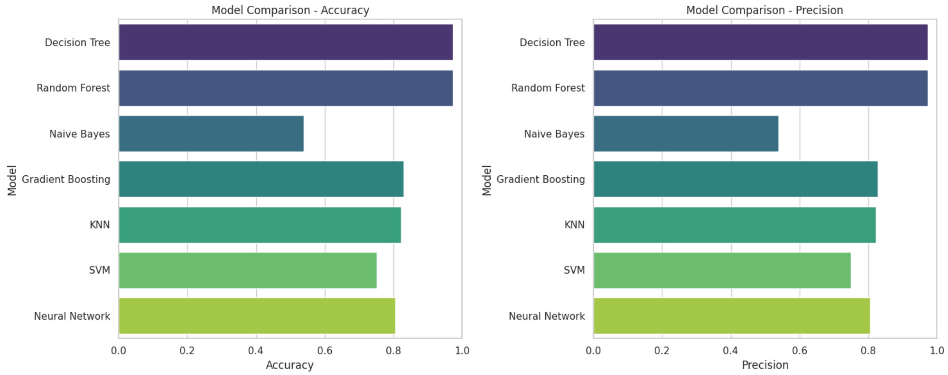

Slide 18
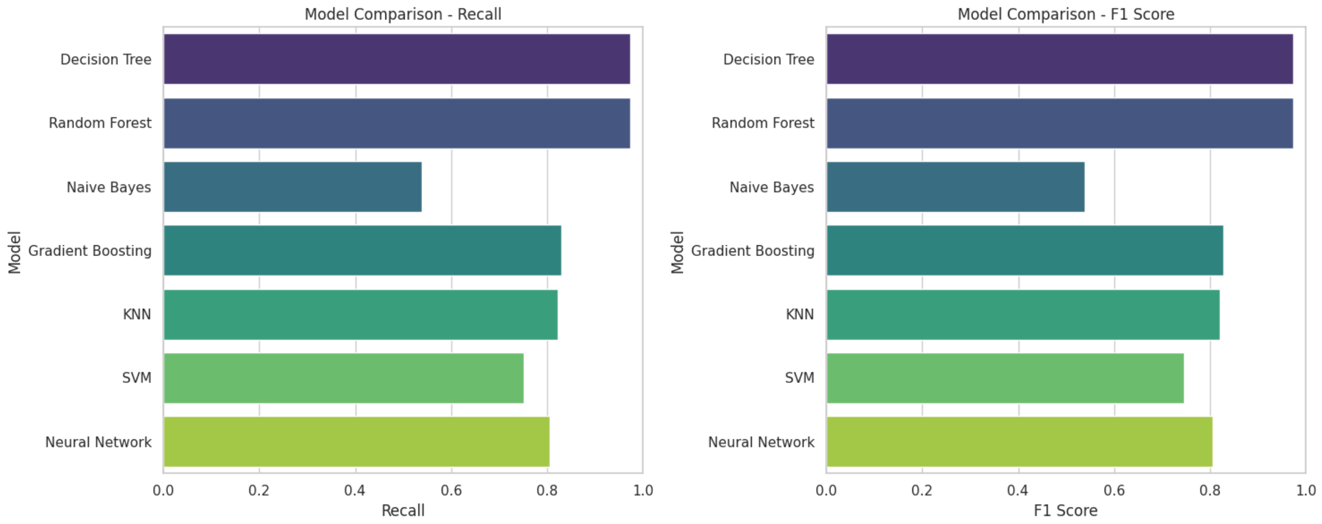

Slide 19
Limitations & Future Work

Slide 20
Limitations
Limited and biased data availability may restrict generalizability.
Ethical concerns and potential biases in handling sensitive health data.
Complexity of postpartum depression may challenge model effectiveness.
Difficulty in interpreting complex models for clinical use.
Need for robust validation across diverse populations and settings.

Slide 21
Future Work
Enhance data collection for broader and less biased datasets.
Explore advanced modeling techniques tailored for healthcare data.
Integrate findings into clinical practice through collaboration with healthcare professionals.
Address ethical concerns rigorously, ensuring privacy and fairness.
Validate models in diverse populations and clinical settings for robustness and applicability.

Slide 22
Conclusion

Slide 23
Our postpartum depression detection models achieved high accuracy, with the best model (Decision Tree) reaching 92%. By identifying key indicators through feature selection, we enhanced model interpretability. This underscores the potential for these models to aid healthcare professionals in early detection and intervention, potentially improving outcomes for new mothers. Future efforts could expand the dataset and integrate advanced models to further enhance predictive performance.

Slide 24
Thank You
Any Questions?

